Slide 1
Pricing CDO Tranches

Slide 2
Background
Model probability density of default levels in collateral, implied in market prices for CDO tranches
Enhancement of approach:
Hull and White (“The Perfect Copula”, 2005)

Slide 3
Definition of CDO
Collateralized debt obligations (CDOs) are a type of asset-backed and structured credit product. CDOs gain exposure to the credit of a portfolio of fixed-income assets and divide the credit risk among different tranches: senior tranches (rated AAA), mezzanine tranches (AA to BB), and equity tranches (unrated). Losses are applied in reverse order of seniority and so junior tranches offer higher coupons (interest rates) to compensate for the added risk. CDOs serve as an important funding vehicle for portfolio investments in credit-risky fixed-income assets.
Basic concept of CDO
CDOs vary in structure and underlying collateral, but the basic principle is the same. First, a CDO entity acquires its inventory - such as income securities asset-backed securities in a cash or synthetic format. Then, the CDO entity sells rights to the cash flows from the inventory along with associated risk. The sold rights are called tranches in accordance with the cash flow and risk assignment rules of the CDO: senior (rated AAA) tranches are paid first followed by mezzanine (AA to BB) tranches and, last of all, equity tranches (unrated).

Slide 4
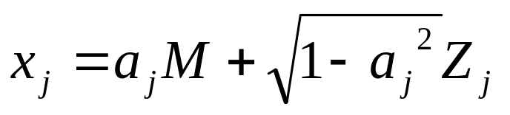
General theory for pricing CDOs
The standard market model is the Gaussian copula model. The structure for this model was suggested by Vasicek (1987) and it was first applied to credit derivatives by Li (2000) and Gregory and Laurent (2003).
Suppose that we are interested in modeling the joint defaults of n different obligors. In a one-factor copula model we first define variables x_{j} (1≤ j ≤ n) by
where
M and Z_{j} ‘s have independent probability distributions
x_{j} can be thought of as a default indicator variable for the jth obligor
x_{j} has two stochastic components:
  M is the same for all xj
  Zj is an idiosyncratic component affecting only x_{j}

Slide 5

Suppose that
t_{j} is the time to default of the jth obligor,
Q_{j} is the cumulative probability distribution of t_{j},
F_{j} is the cumulative probability distribution for x_{j}.
The copula model maps x_{j} to t_{j} on a “percentile to percentile” basis.
The 5% point on the x_{j} distribution is mapped to the 5% point on the t_{j} distribution; the 10% point on the x_{j} distribution is mapped to the 10% point on the t_{j} distribution; and so on. (Hull 2006)
Other words, x is mapped to t as follows
The essence of a copula model is that we do not define the correlation structure between the variables of interest directly. We map the variables of interest into other more manageable variables and define a correlation structure between those variables.

Slide 6
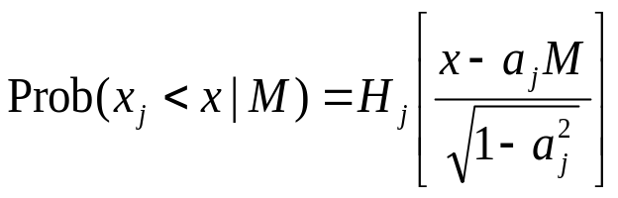
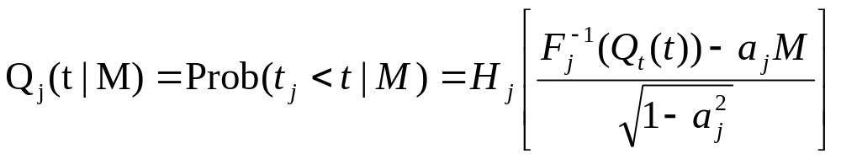
From our assumptions it follows that
where H_{j} is the cumulative probability distribution of Z_{j}.
Conditional on M, defaults are independent.
When using the model to value a CDO tranche we set up a procedure to calculate expected cash flows on the tranche conditional on M and then integrate over M to obtain the unconditional expected cash flows.

Slide 7
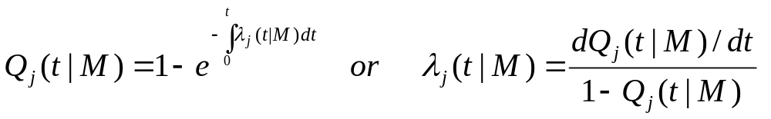
Instead of formulating the model in terms of conditional Q’s we can instead use
conditional hazard rates. Define λ_{j} ( t | M ) as the hazard rate at time t conditional on M for company j, then the dependence between λ_{j} ( t | M ) and Q_{j} ( t | M ) can be written as
The last equation can be used to calculate the hazard rate as a function of time for alternative values of M.

Slide 8
Pricing
The homogeneous one-factor copula model implies a set of paths for the hazard rates of obligors.
The probability of each path occurring is determined by the probability distribution for M.
Each hazard rate path represents a future credit environment.
The set of all possible hazard rate paths and their probabilities is the distribution of future credit environments, it is the only information we need about the underlying copula in order to value a CDO tranche or similar instrument.
We calculate expected cash inflows and expected cash outflows on the CDO tranche for a particular future credit environment .
To value a CDO tranche we integrate these expected cash flows over the distribution of future credit environments.

Slide 9
Summary of what is done in this project
Suppose we know possible default levels {d₁,…d_{n}} (only one obligor is observing here) (it means that for each d_{i} we know conditional hazard rate λ( t | M = d_{i} ))
Our goal is to assign probabilities to this default levels having tranche prices.
We do it as follows:
Simulate sample paths for all hazard rates.
Calculate expected cash inflows and expected cash outflows on the CDO tranche for a particular hazard rate.
Integrate these expected cash flows over the distribution of hazard rates to value CDO.
Having real CDO prices choose optimal distribution of hazard rates using maximum entropy principle and some other constraints.

Slide 10

Input Data
Default Loss Levels
  Prices for different levels are equally spaced
Default Scenarios
  time to default table (CDO Evaluator or Simulation from the hazard rates)
Market Prices of benchmark tranches

Slide 11


Position Profit in Default
Define
= (expected cashflow of tranche j for default level ) –
– (price of tranche j)
Calculate
= (mean of cashflows in all scenarios with default level ) –
– (price of tranche j)

Slide 12


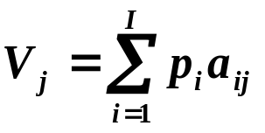
Optimization Problem Statement
Notations
  = implied probability of default level (decision variable)
  = expected risk-neutral profit from tranche j

Slide 13
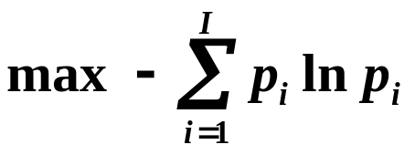

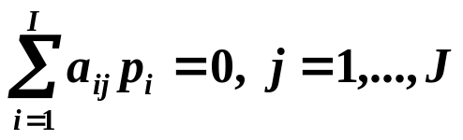
Optimization Problem Statement
Objective
(maximum entropy principle)
Subject to
(probability definition)
(non-arbitrage conditions)

Slide 14




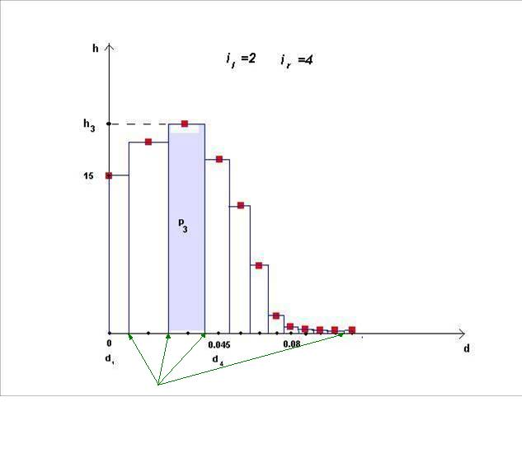


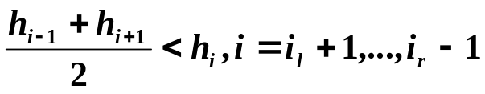


Unimodality Constraints
We assume that our distribution of implied probabilities is unimodal
Choose and :main hump of probability histogram is between and
= height of bar
Unimodality constraints:
(monotonicity of left slope)
(concavity of hump)
(monotonicity of right slope)

Slide 15
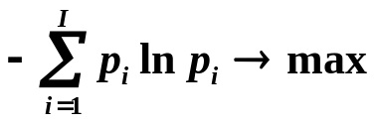
Optimization with Unimodality
Optimization
(maximum entropy principle)
Constraints
(probability definition)
(non-arbitrage conditions)
(set of unimodality constraints)

Slide 16
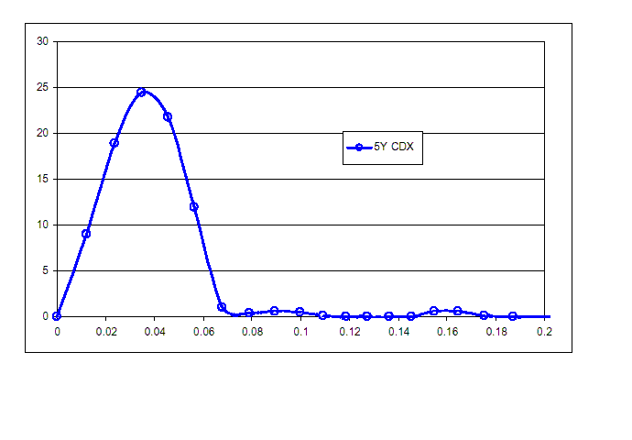
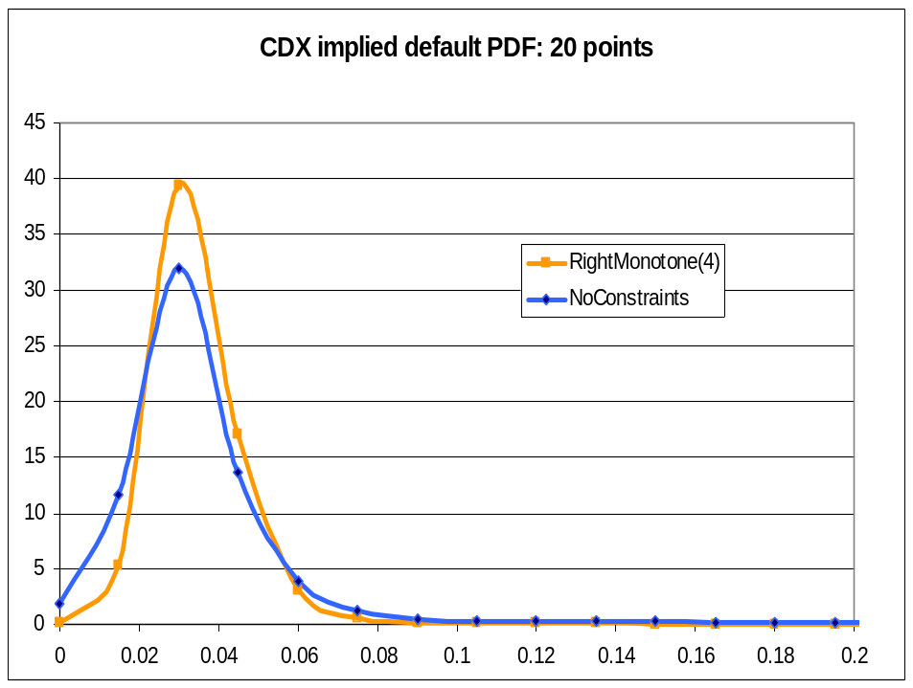
Results
5-year CDX IG on August 30, 2005,
20 points
Hull’s result:
Our result:

Slide 17
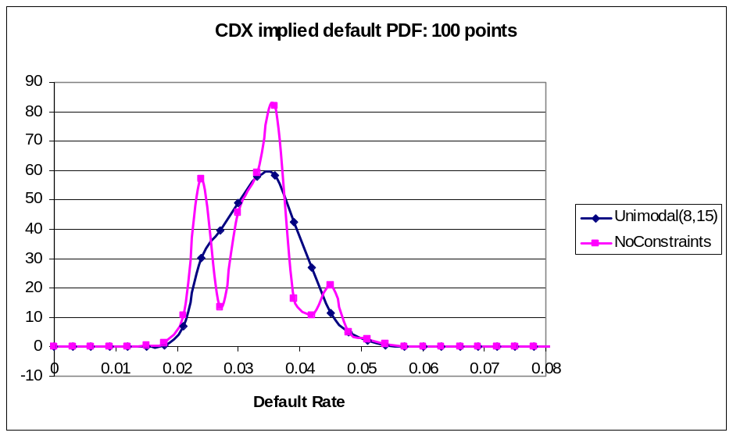
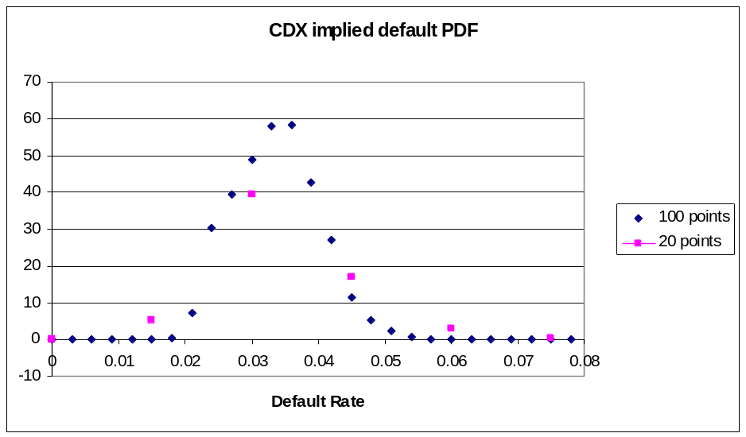
Results
5-year CDX IG on August 30, 2005,
100 points
Comparison of 20 points and 100 points results:

Slide 18
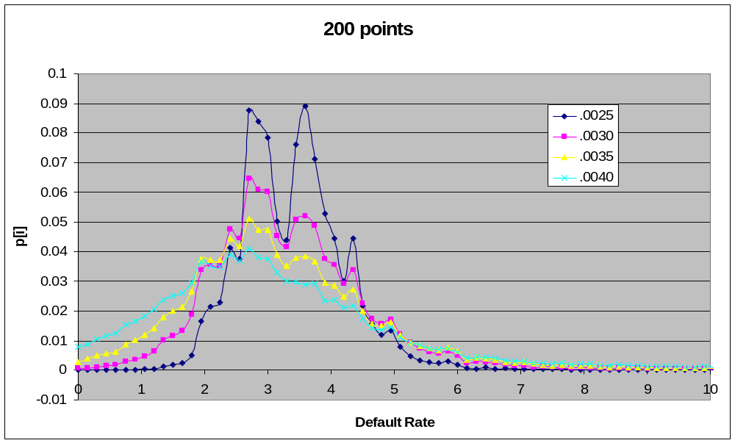
Results
5-year CDX IG on August 30, 2005,
different fitting precisions

Slide 19
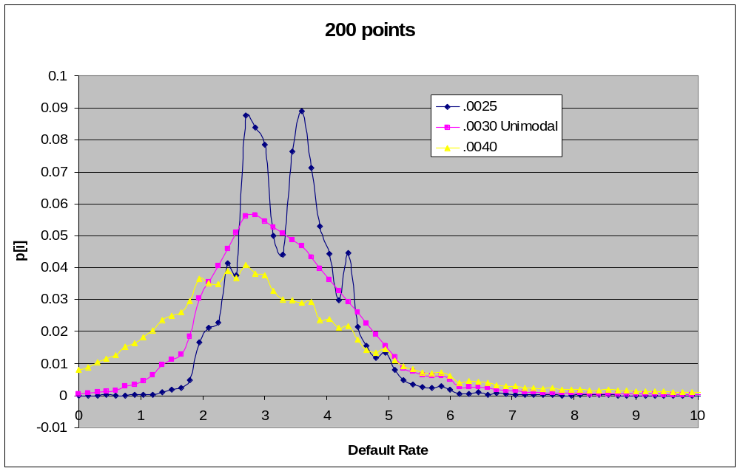
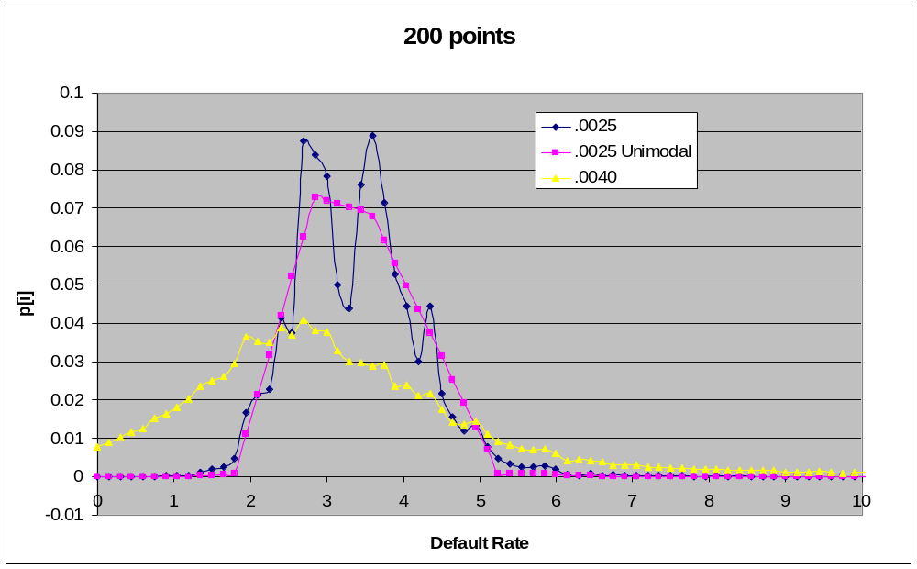
Results
5-year CDX IG on August 30, 2005 Unimodality with relaxed precision:
Unimodality:

Slide 20
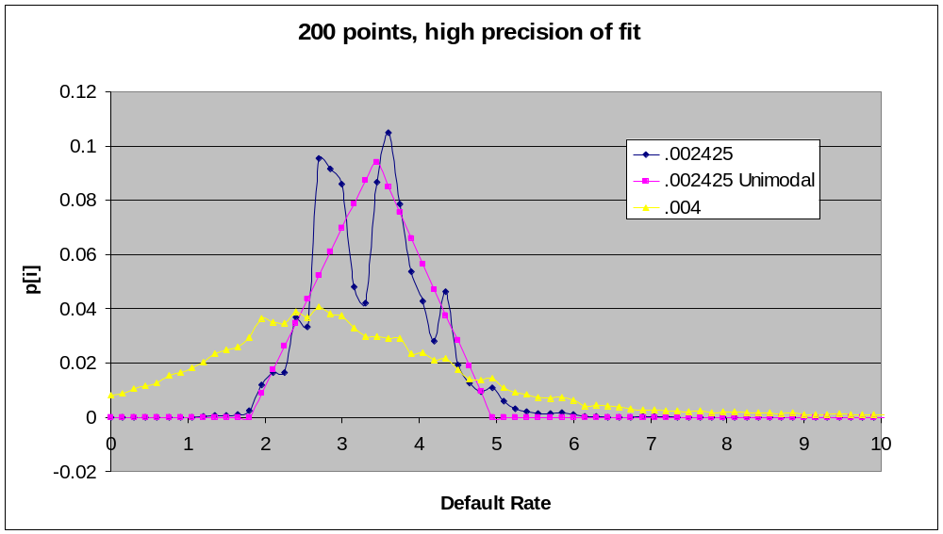
Results
5-year CDX IG on August 30, 2005,
.002425:
Highest possible precision of fit under which the problem is feasible

